Slide 1
Color
06
I399 Web Development

Slide 2
Color Theory

Slide 3

Do we all see color in the same way?
It’s not easy being green...
http://www.empiricalzeal.com/2012/06/05/the-crayola-fication-of-the-world-how-we-gave-colors-names-and-it-messed-with-our-brains-part-i/
Notes:
http://www.empiricalzeal.com/2012/06/05/the-crayola-fication-of-the-world-how-we-gave-colors-names-and-it-messed-with-our-brains-part-i/

Slide 4
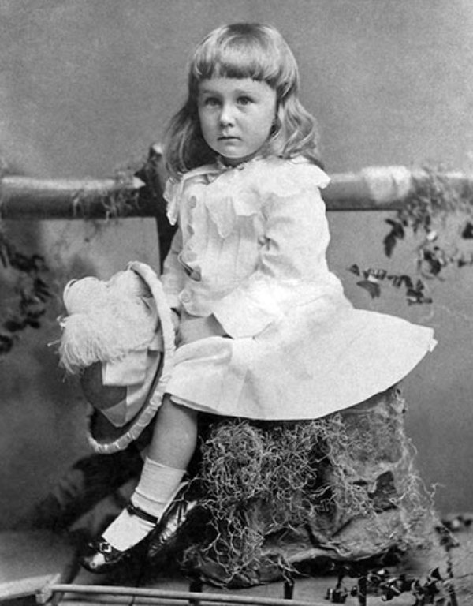
Who is this?
Franklin Roosevelt, 1884

Slide 5
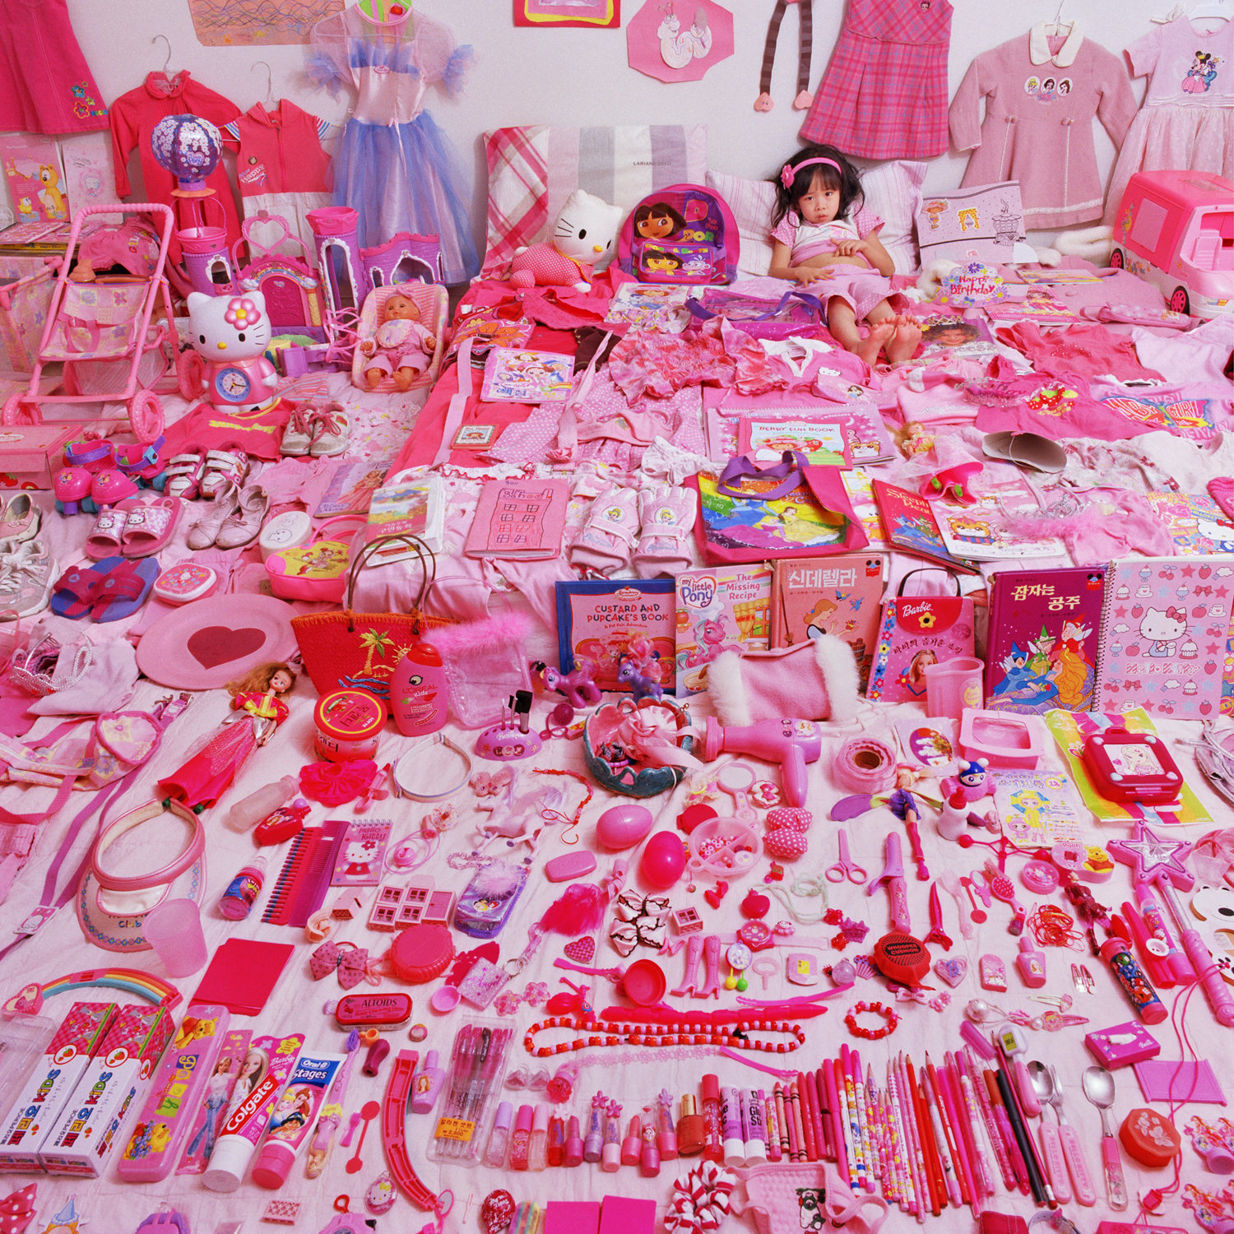
When did pink become a color meaning “girl”?
http://www.smithsonianmag.com/arts-culture/when-did-girls-start-wearing-pink-1370097/?all&no-ist
Notes:
A June 1918 article from the trade publication Earnshaw's Infants' Department said, “The generally accepted rule is pink for the boys, and blue for the girls. The reason is that pink, being a more decided and stronger color, is more suitable for the boy, while blue, which is more delicate and dainty, is prettier for the girl.” Other sources said blue was flattering for blonds, pink for brunettes; or blue was for blue-eyed babies, pink for brown-eyed babies, according to Paoletti.
1940s - it had switched and after WW2, baby boomers were raised to dress like “mom” or “dad”.
1970s - nurture over nature
1985 - prenatal testing more prevalent, marketing picks up on this.
1963 - precise mixing to get exact colors
2000s - global / marketing

Slide 6
EXERCISE - IN PAIRS - 2 MINUTES:
Person #1 - Close your eyes. Please pretend to be blind from birth for a moment. Remember, you don’t know what the world looks like through eyes.
Person #2 - Pick your favorite color - NOT BLACK. Now describe that color to your “blind” friend.

Slide 7
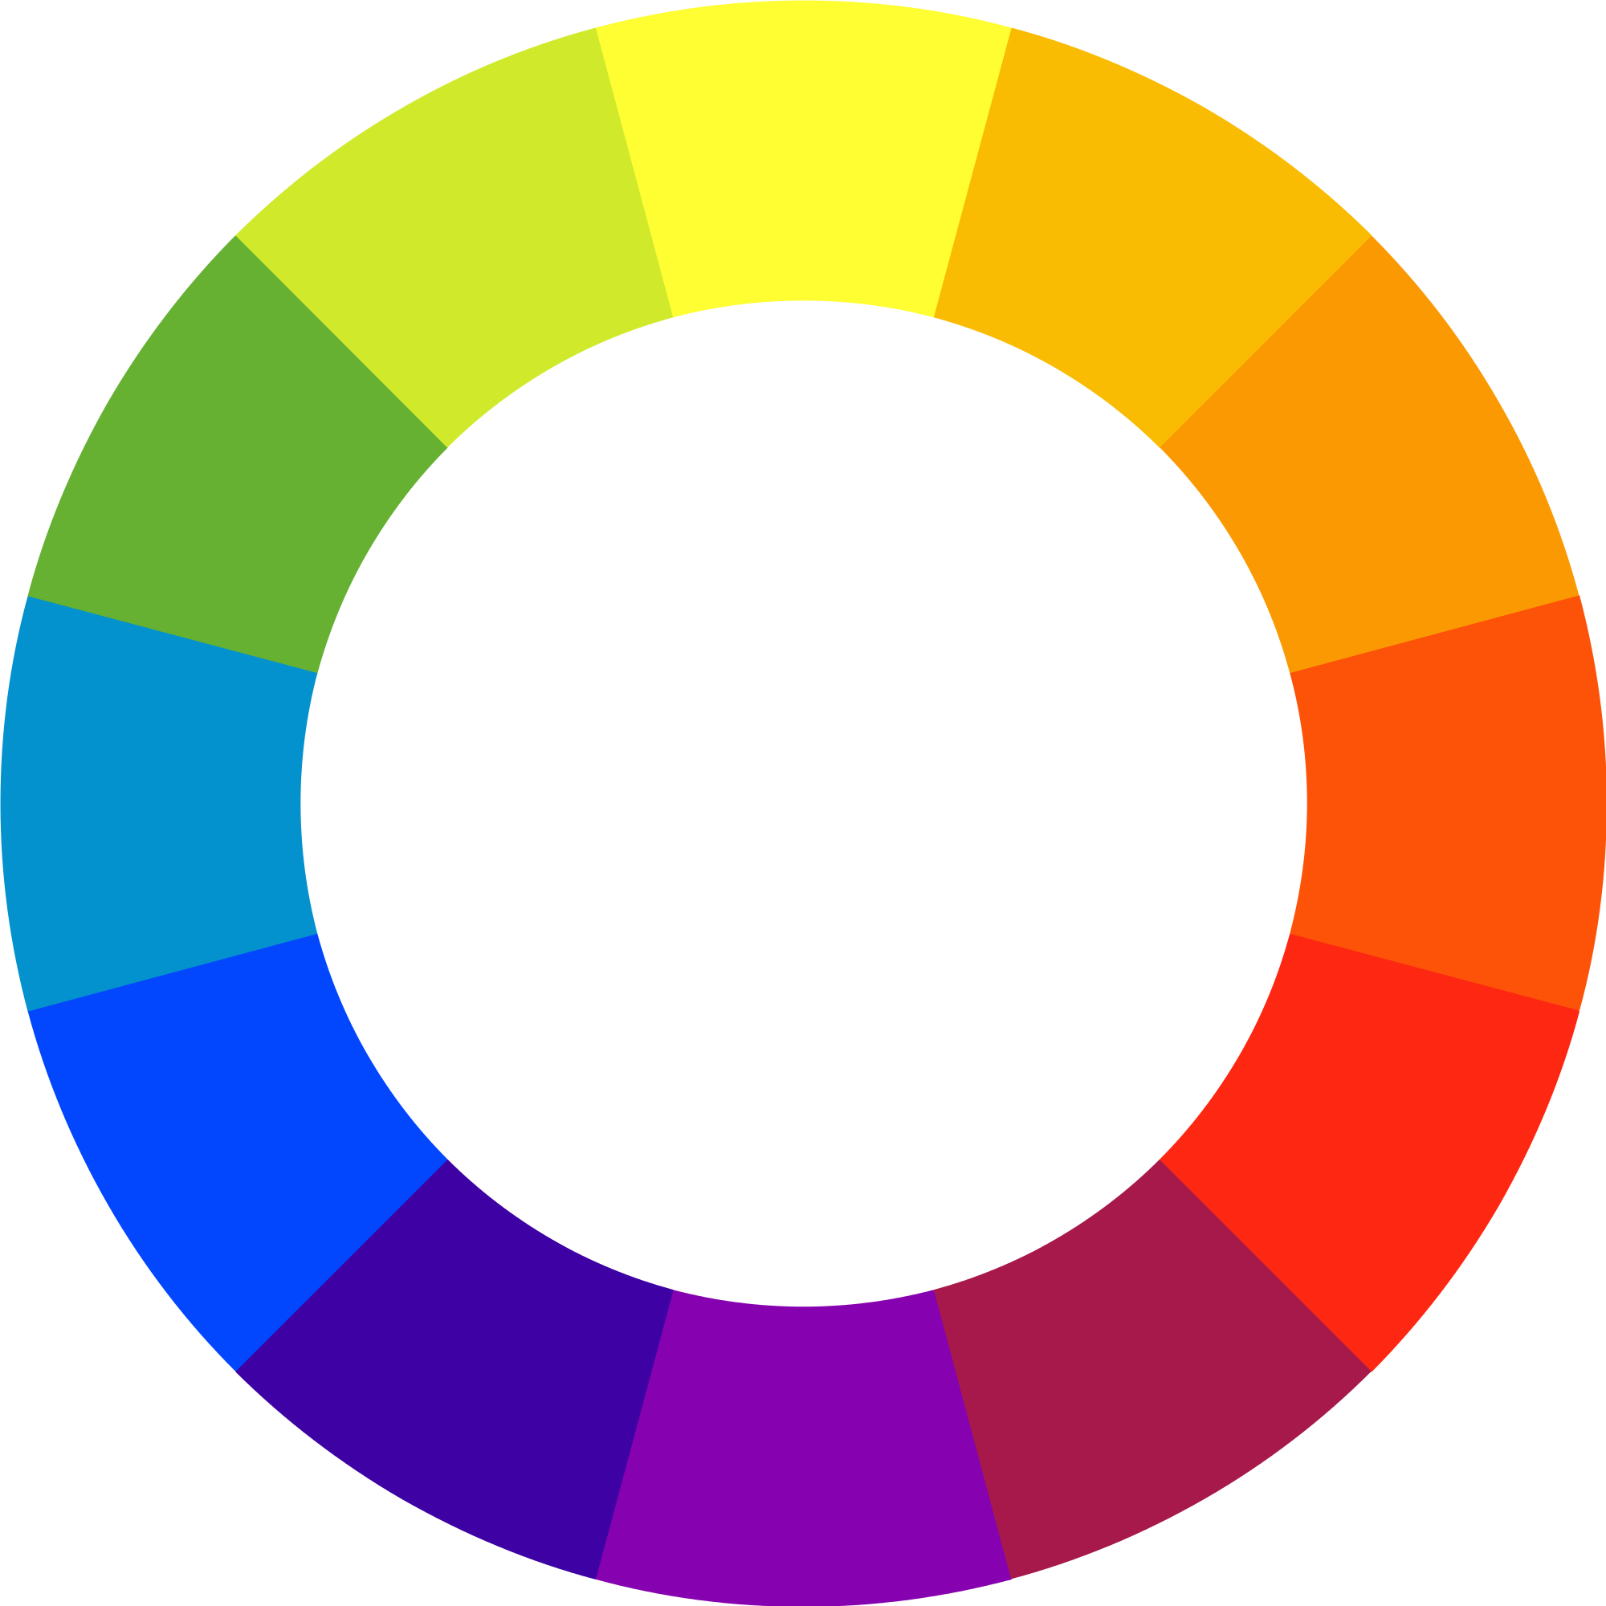
How do we classify colors?
Notes:
The first color wheel has been attributed to Sir Isaac Newton, who in 1706 arranged red, orange, yellow, green, blue, indigo, and violet into a natural progression on a rotating disk. As the disk spins, the colors blur together so rapidly that the human eye sees white. From there the organization of color has taken many forms, from tables and charts, to triangles and and wheels the history.

Slide 8
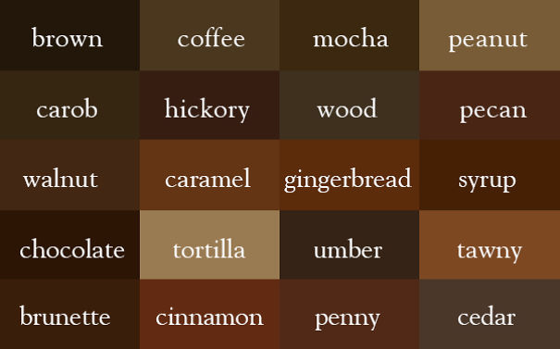
Notes:
Names that relate the color to our senses. The names relate to something in the real world that we can see / taste / smell.

Slide 9
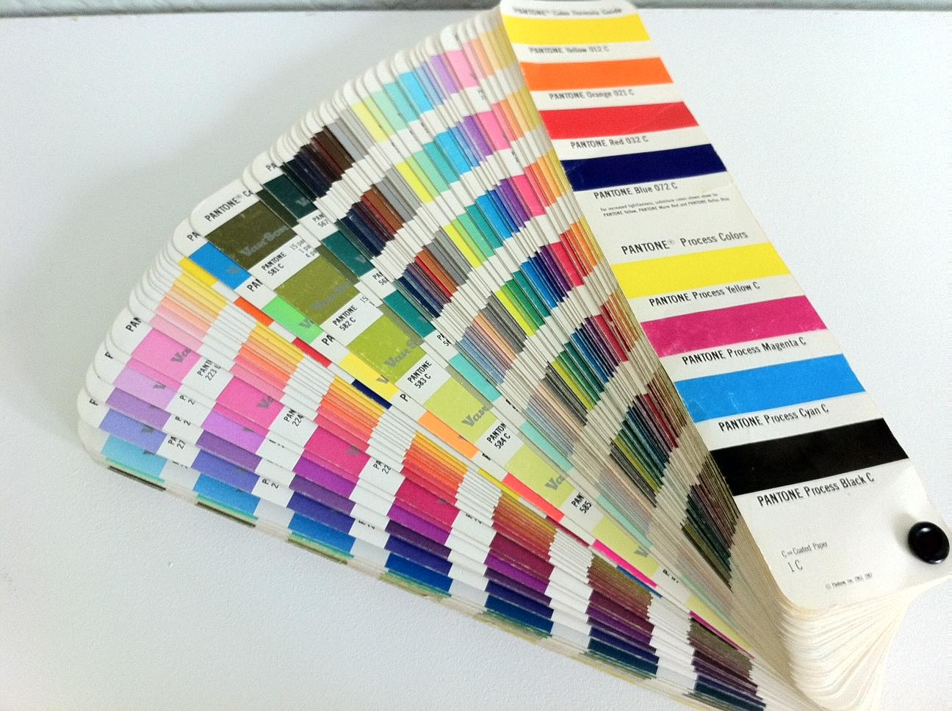
Pantone (PMS)
https://www.fastcodesign.com/3050240/how-pantone-became-the-definitive-language-of-color
Notes:
Pantone - a key for how to mix colors precisely - used widely in print and design

Slide 10

Did you know there is a Facebook blue?
http://www.fastcompany.com/3009317/why-is-facebook-blue-the-science-behind-colors-in-marketing
Notes:
Most companies have an official set of Pantone colors for their brand

Slide 11
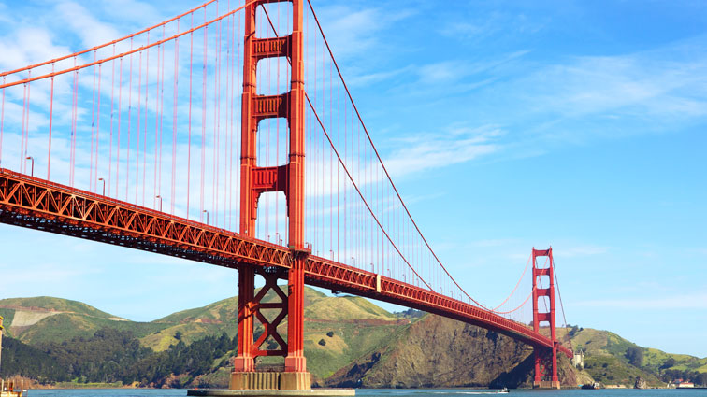
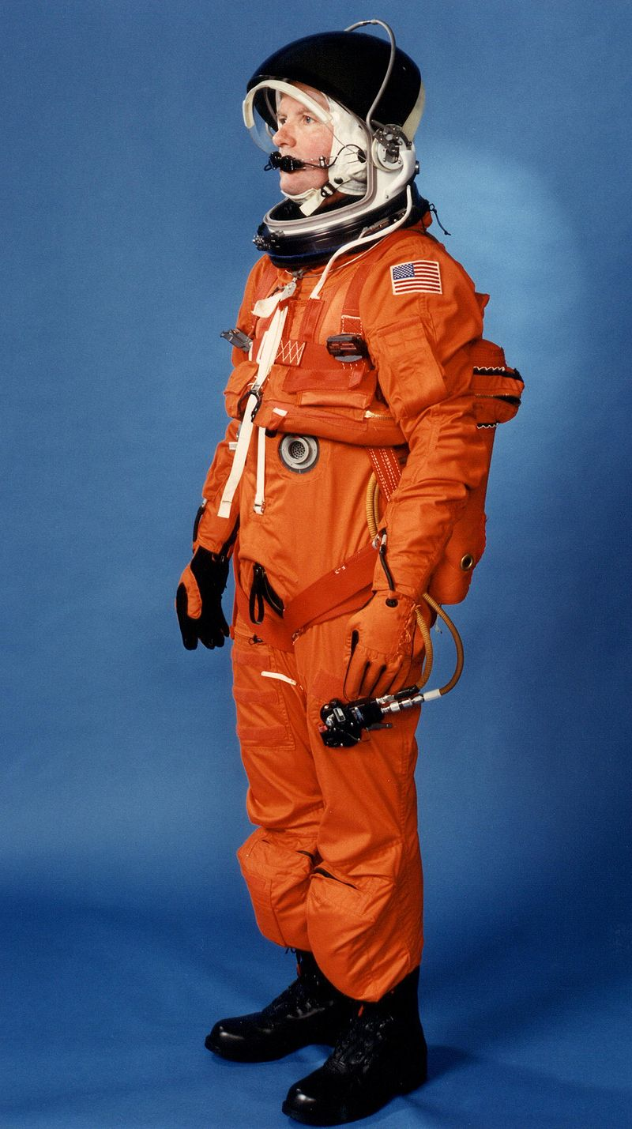
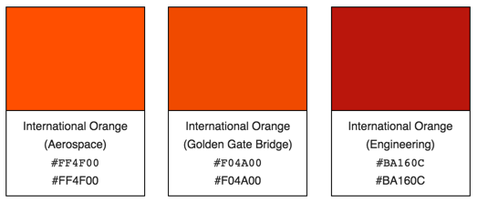

Slide 12
Color Attributes
How can we describe color more precisely?

Slide 13
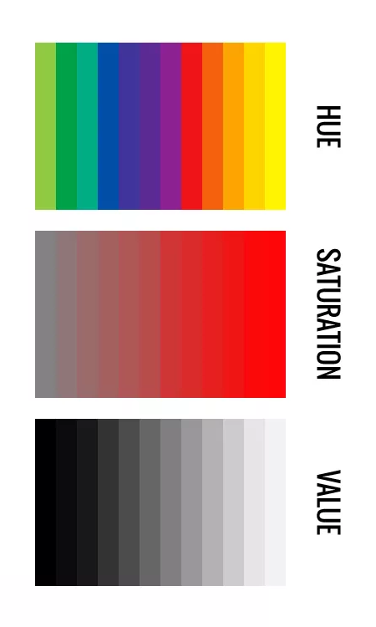
Color has four attributes:
Hue
Saturation
Value
Temperature

Slide 14
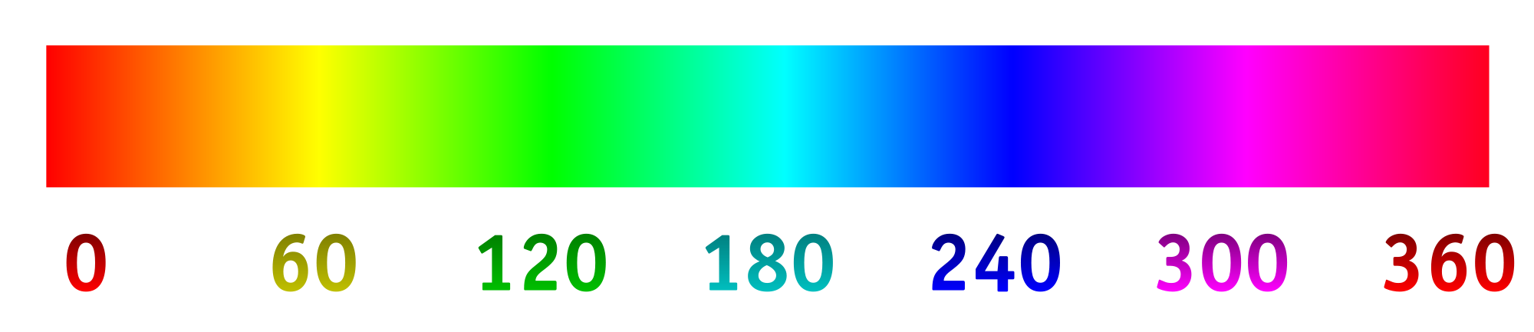
HUE
1
… where the color falls on the spectrum of visible light.
A color is “red” or “blue” or “green” in hue, for example.

Slide 15
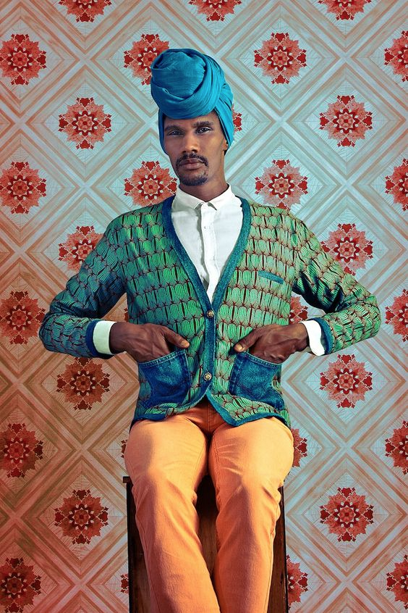
What hues are
present?
Omar Victor Diop

Slide 16
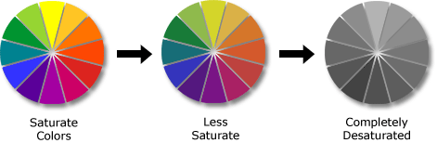
SATURATION
2
…how vivid (pure, from solar spectrum) or dull (diluted, mixed).

Slide 17
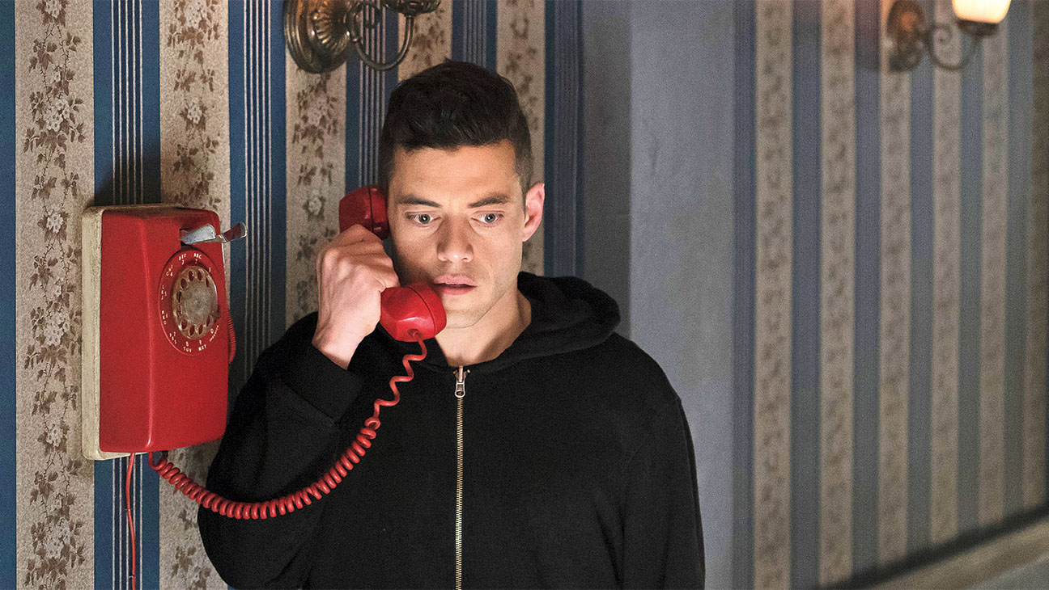
Discuss the saturation levels in this image with your neighbors.
Mr Robot

Slide 18
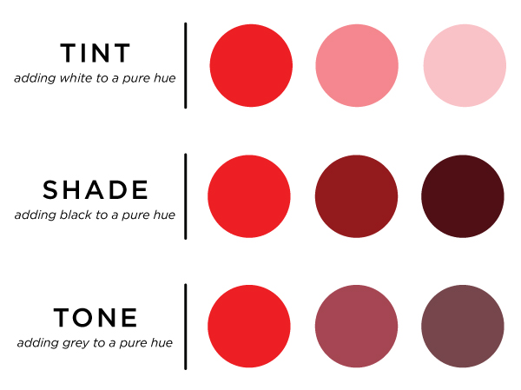
VALUE
3
…how light or dark the color is -- tints, tones, shades

Slide 19
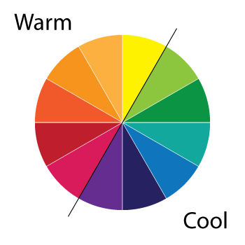
TEMPERATURE
4
…perception of warmth (warm colors) or coolness (cool colors)
WARM - red/orange/yellow
COOL - green/blue/purple

Slide 20
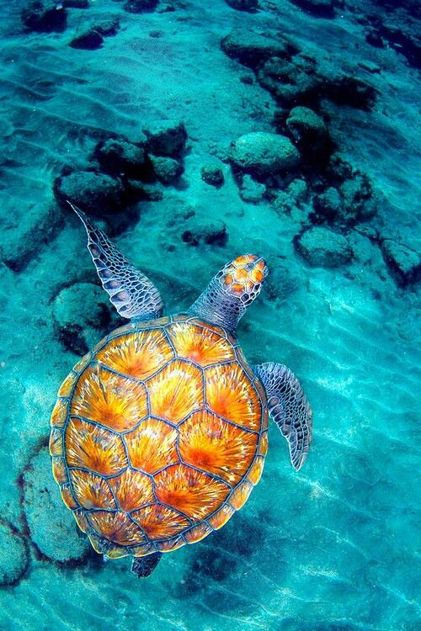
Describe the temperature of the colors in this image.

Slide 21
EXERCISE - IN GROUPS - 3 MINUTES:
We’re going to all analyze a color together.. When the color is announced, (1) write its name at the top of your board.
(2) Divide the board into FOUR boxes, and then label:
Good or nice things that are this color
Neutral, bad or icky things that are this color
Phrases in English that use the color OR Cultural examples for how the color is used
Companies or products that use this color for branding and marketing

Slide 22
EXERCISE - IN GROUPS - 3 MINUTES:
(3) After filling in these spaces, brainstorm adjectives that are inspired by the color -- both positive and negative.
We often associate meaning, cultural significance and emotions with color, often subconsciously.

Slide 23
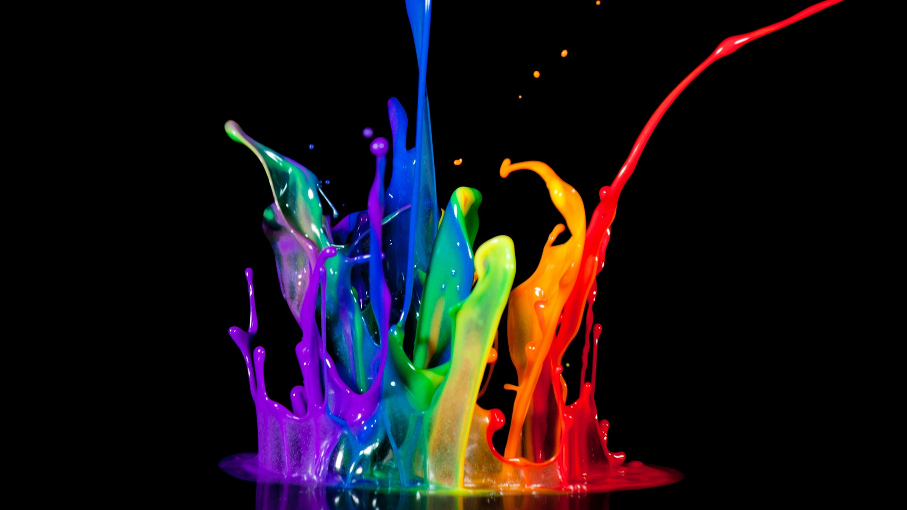
Color is a powerful and evocative tool — primarily because it works on a subliminal level.
Color is a powerful and evocative tool — primarily because it works on a subliminal level.

Slide 24
Color + HTML

Slide 25
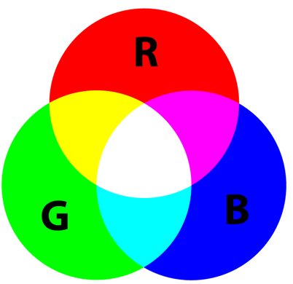
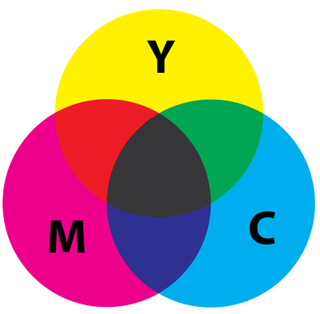
Additive Color
Colors on a computer screen are created with light. Additive color mixing begins with black and ends with white; as more color is added, the result is lighter and tends towards white.
RGB is an additive color system.
Use for digital projects.
Subtractive Color
Used in painting and printing. Subtractive color mixing means beginning with white and ending with black; as color is added, the resulting tone gets darker and tends towards black.
CMYK is a subtractive color system.
Use for print projects.

Slide 26
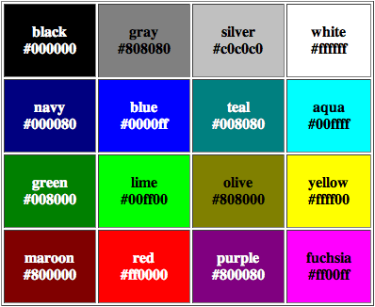
#hexcodes
Hexcodes are made up of a hash sign (#) followed by three pairs of hexadecimal numbers.
The number pairs represent, in order, red green blue.

Slide 27
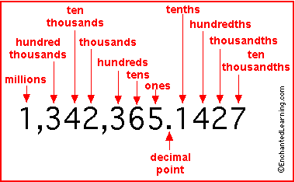
Base ten: decimal
We humans love the decimal system.
Maybe it has to do with our ten fingers or our ten toes, but most everything we do in math relates to the sequence 1, 2, 3, 4, 5, 6, 7, 8, 9, 10...

Slide 28
Base two: binary
Computers, on the other hand, prefer the simpler world of ones and zeros where 0, 1, 2, 3, 4 and so on is represented as 0, 1, 10, 11, 100...
“There are only 10 types of people in the world: those who understand binary, and those who don't.”
http://www.youtube.com/watch?v=B1BdQcJ2ZYY

Slide 29
Base sixteen: hexadecimal
HTML prefers colors as hex values:
0, 1, 2, 3, 4, 5, 6, 7, 8, 9, a, b, c, d, e, f...
CSS uses three hex pairs to represent the amount of red, green and blue.
#RED GREEN BLUE;
#000000;
#FFFFFF;

Slide 30
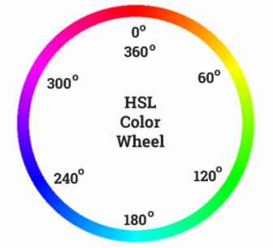
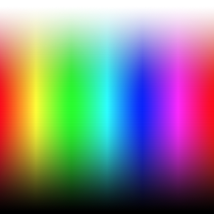
Color Spaces
HSL Hue, saturation, light
BLUE: hsl(240, 100%, 50%);
RGB Red, green, blue - from 0 to 255
BLUE: rgb(0, 0, 255);
CMYK Cyan, Magenta, Yellow, Key/Black
BLUE: cmyk(100%, 100%, 0%, 0%);

Slide 31
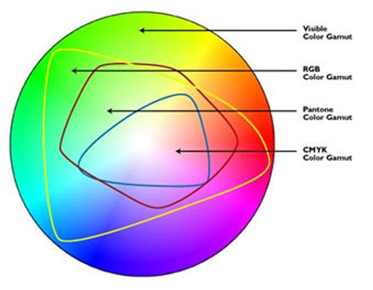
"Web safe colors" no longer needed
Although a monitor may be able to display 'true color' (16,000,000 colors), millions of these colors are outside of the spectrum available to printers.

Slide 32
Choosing Colors

Slide 33
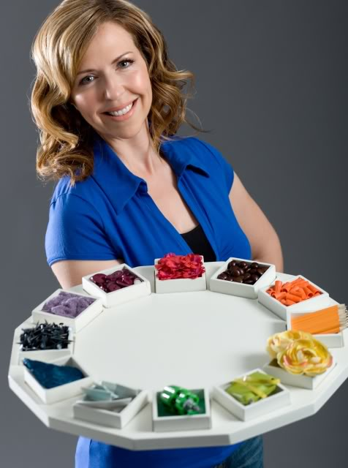
http://www.janelockhart.com/portfolio/makeovers.php

Slide 34
One possible method for picking a color palette.
Choosing colors for your design is hard work, even though it seems like it should be easy.. Just pick a color, right?
But you are capable of making design decisions and you can at least take this cognitive shift. Picking colors (well) is actually quite hard, but it can be learned.
Color is information. We don’t code at random, and we shouldn’t pick colors at random either.
The following method is from:
Practical Color Theory for People Who Code Natalia Shelburne
http://tallys.github.io/color-theory/

Slide 35

Pick a color by hue
This is what our website would look like if everything was this hue in its most saturated, chromatic, colorful state. (Hue)

Slide 36
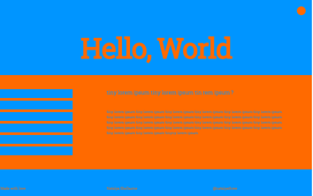
Find the complementary color This is the color across from our original hue on the color wheel. If we mixed the two together, we would get grey.
With two hues, we can see the elements on our website. Notice that because of the high saturation, the colors seem to vibrate to our eyes. (Warm + Cool / Temperature)

Slide 37
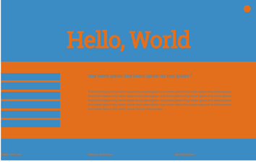
Mix the colors. Create a relationship.
Mixing a bit of one into the other (and visa versa) makes the colors seem like they are in the same lighting conditions. This echoes what we subconsciously know from nature. It also has the effect of desaturating the tones from their original brilliance. (Saturation)

Slide 38

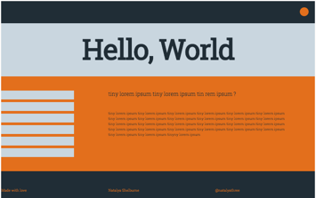
Create neutrals.
To let your original color (your “call to action” color) pop, surround it with neutrals. Vary the neutral’s lightness to create highlights and shadows. (Value)

Slide 39

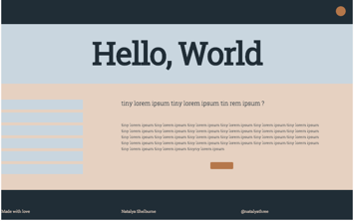
Create neutrals.
Do the same with our primary color. Now nothing on the screen is irritating to our eyes. We’ve done a good job of creating a lot of forgettable, bland colors… (Value)

Slide 40

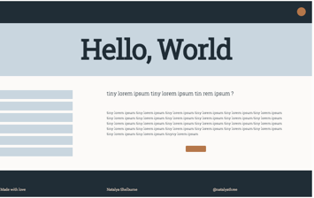
Add “black” and “white”.
Notice neither of these is pure! Mix in a touch of your other colors to get a not-quite black and a not-quite white.
We’ve lost the contrast. We should be able to tell elements in our site apart even if it were in b&w. Use a tone of black and white to ground the color choices you’ve made.

Slide 41

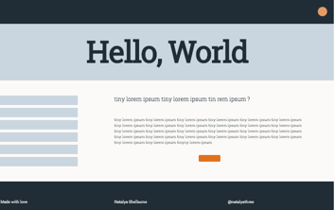
Add the “pop”!
Notice that the circle in the header is a tint of the original orange. Using tints and shades for accents to provide just the right amount of contrast, and useful to have on hand for hover states.
Adding a fully-saturated bit of our original color back into our site allows our call-to-action to be clear.

Slide 42
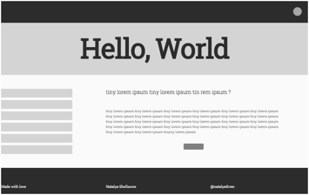
Turn off all color. Check the contrast.
If we have the contrast appropriately balanced, we should still be able to see all the elements on our site even if the color is taken away.

Slide 43
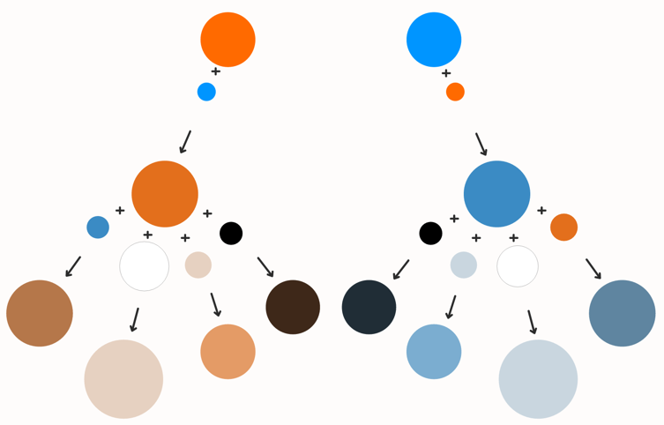
Creating a color palette involves paying attention to relationships between colors. The ideal goal is a color scheme complex enough to be interesting, but simple enough to be maintainable, just like your website code.

Slide 44
EXERCISE - ON YOUR OWN:
Use color.adobe.com to create a color palette for a restaurant’s website.
Make sure you have a specific place OR food genre in mind.
Start with an image, a specific color, or just an idea.. But do make a starting choice.
When you’ve created something you think will work, discuss the success of your color palette with a neighbor.

Slide 45
Color Resources
Firefox/Chrome Add-on
http://www.colorzilla.com/
Color schemes
http://www.colorhexa.com/
https://coolors.co/
https://color.adobe.com/create/color-wheel/

Slide 46
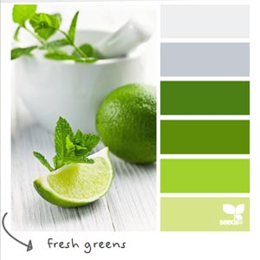
Color Resources
Design inspiration based on color (good for testing out whether your combination will work)
http://labs.tineye.com/multicolr/
http://designspiration.net/
For finding just the right color
https://color.hailpixel.com/
RGB / Hex Color Converter
http://hex.colorrrs.com/

